Slide 1




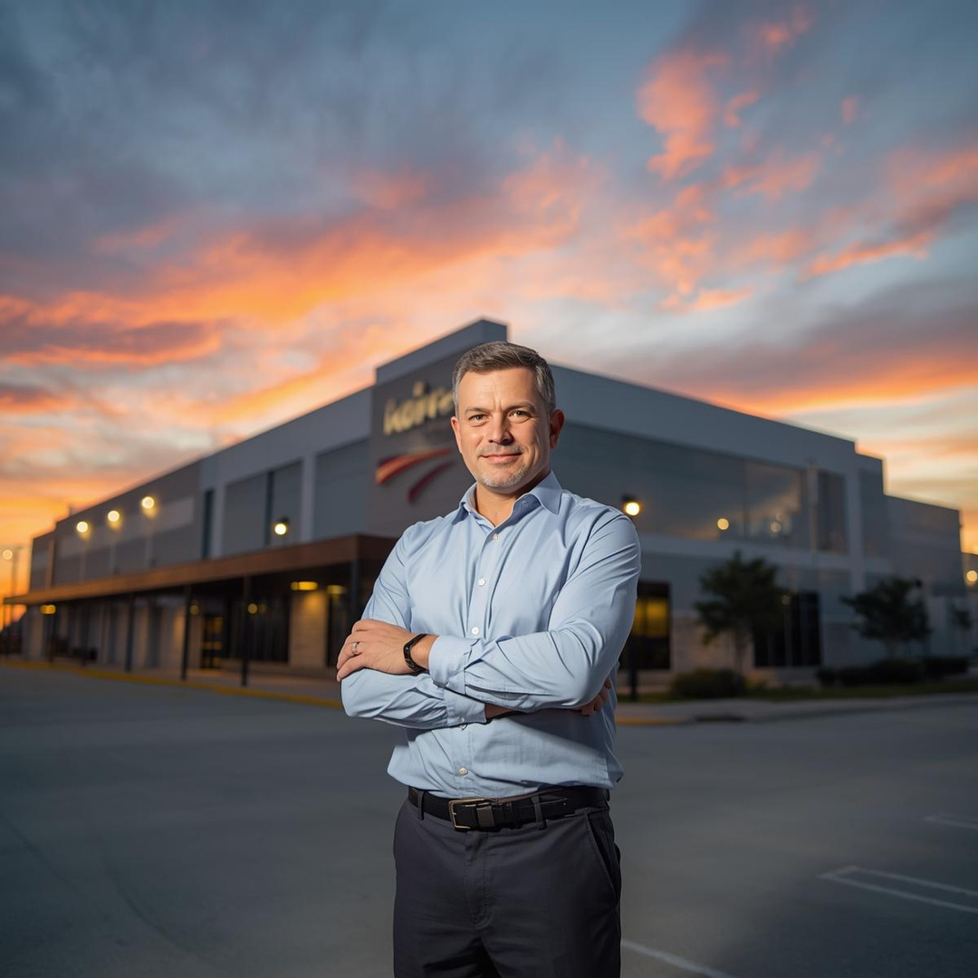
Industry Leading
Life Safety & Security
for Modern Facilities
Trusted by Texas businesses since 1978 to protect people, property, and productivity.

Slide 2

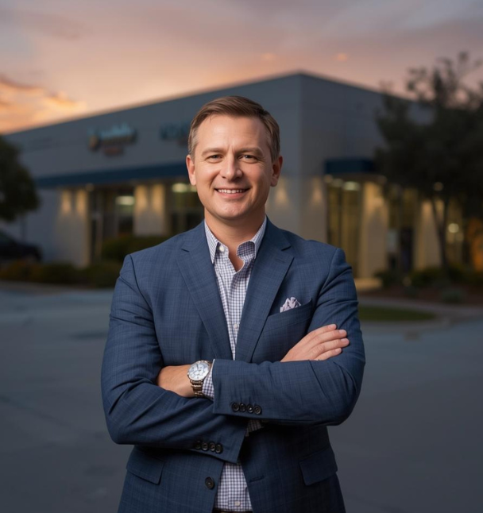
What We Deliver
Complete System Integration for Safer, Smarter Facilities
One partner for fire, security, communications, and cabling
Systems that work together reliably
Designed for your building’s needs, not generic templates
Installed and supported by certified professionals

Slide 3
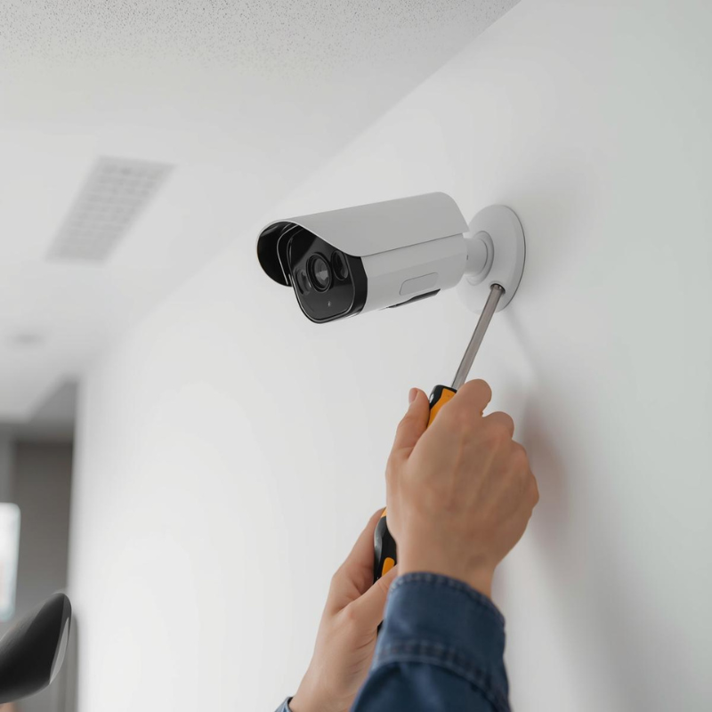
Why Facilities Choose DSC
Built Around Your Need for Reliability & Simplicity
Clear path from design to installation
Fewer vendors to manage
Predictable scheduling and communication
Systems built to last and expand

Slide 4
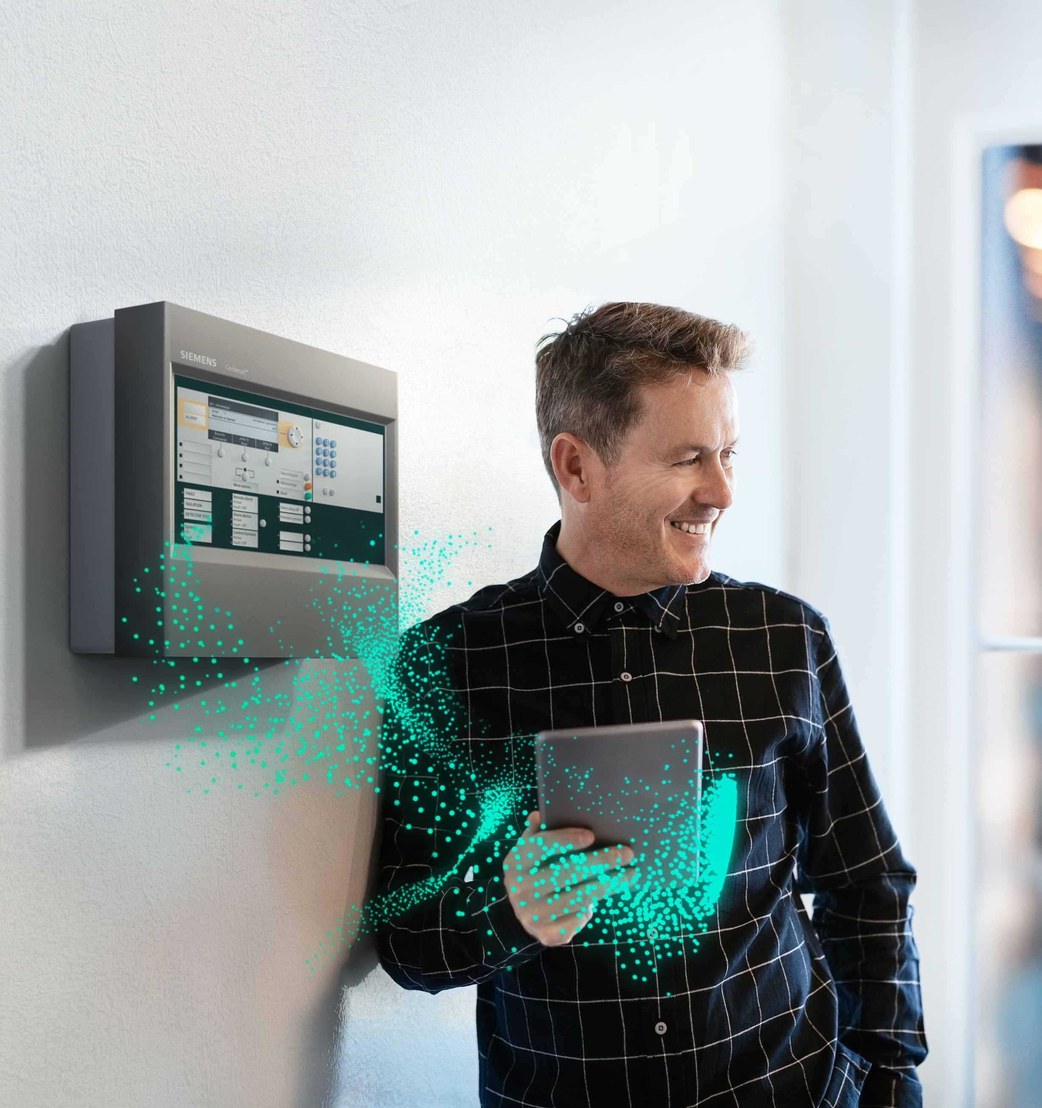
Fire & Life Safety Systems
Code-Compliant, Reliable Detection and Notification
Addressable systems engineered for your facility
Code-based design and documentation
Streamlined inspections and easy AHJ coordination
Timely installation with clean workmanship

Slide 5
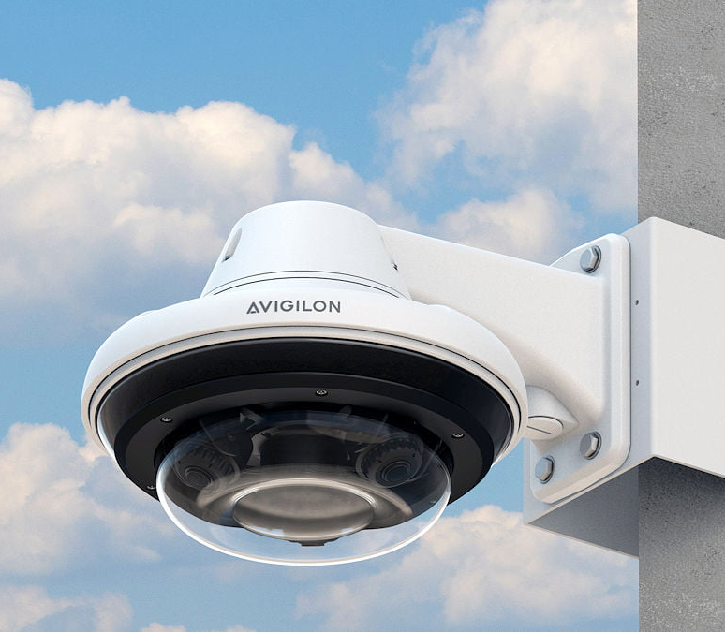
Video Surveillance
Visibility That Supports Safety, Security, and Operations
Cameras, mounts, recorders, and VMS solutions
Local or cloud-based recording options
Coverage designed for how your facility is utilized
Flexible for expansions and remodels

Slide 6

Access Control
Simple, Scalable Control of How People Move Through Your Facility
Secure entry and credential management
Door hardware, readers, and controllers
Remote management options
Integrates with video and communications

Slide 7
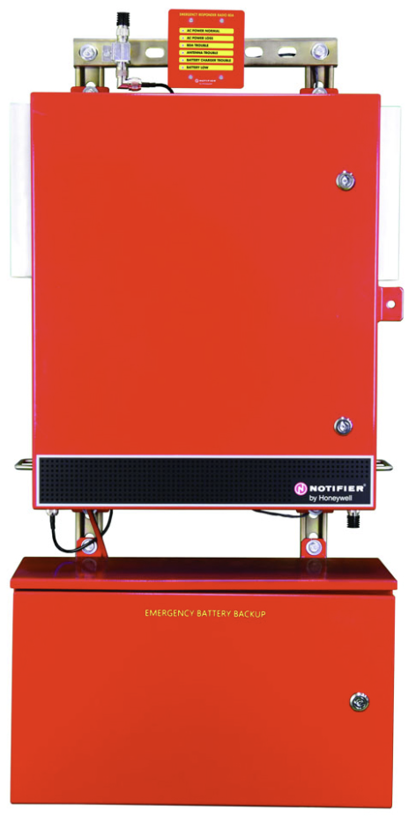
BDA/Emergency Radio
Reliable Radio Coverage for First Responders
NFPA/IFC-compliant systems
Testing, design, and installation
Keeps first responders connected where radio coverage fails
Required in many modern facilities

Slide 8
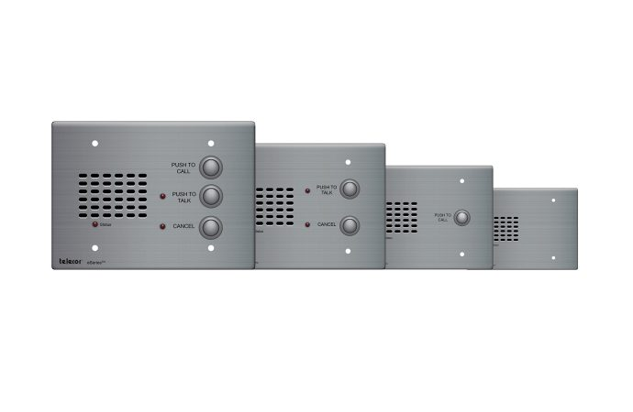
Communication Systems
Clear Communication for Day-to-Day Operations and Emergencies
Paging, intercoms, and facility audio
Integrated notifications
Supports staff coordination and safety needs

Slide 9

Structured Cabling
The Backbone That Keeps Every System Connected
Network cabling for all low-voltage systems
Clean, labeled, professional installation
Supports future expansion and system upgrades

Slide 10
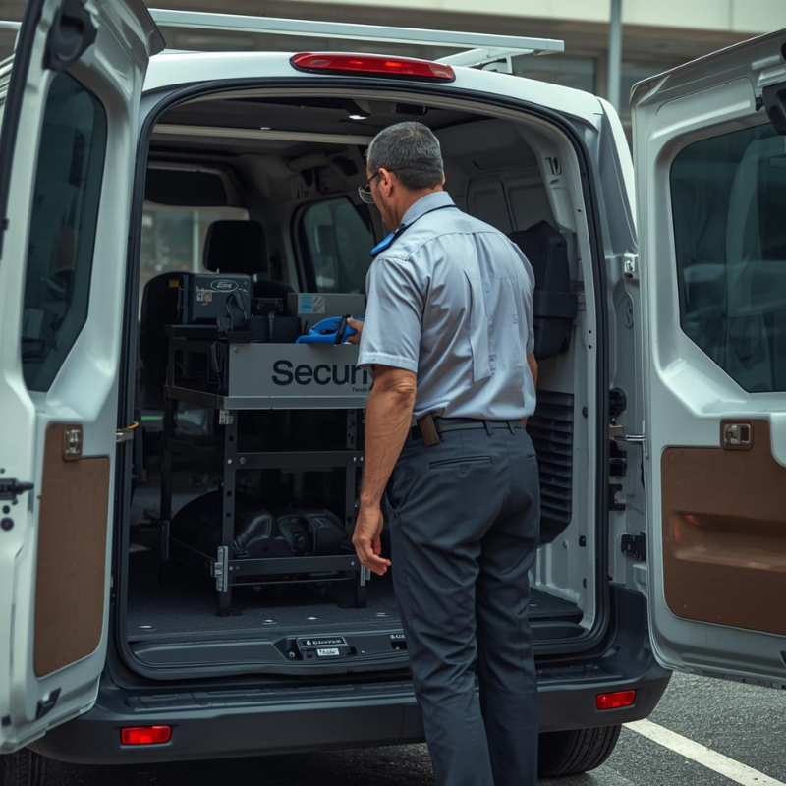
Service, Maintenance & Support
Long-Term System Reliability You Can Count On
24/7 on-call support
Preventive maintenance programs
Routine inspections and testing
Repairs, troubleshooting, and replacement as needed
Certified technicians across all major system types

Slide 11
Our Commitment to You
A Reliable Partner for the Life of Your Facility
Straightforward communication
Predictable scheduling
Clean installation and documentation
Systems built for long-term performance
Accountability you don’t get from volume-based vendors

Slide 12

Thanks for Your Time!
Phone: (713) 464-8407
Email: sales@thinkdsc.com
Web: www.thinkdsc.com

